Slide 1
Gerunds and infinitives in hindi and english

Slide 2
Pires draws a distinction between acc-ing and poss-ing that was not made in Abney.
For Pires Acc-ing are clausal, and more like ECM than they are like DPs.

Slide 3
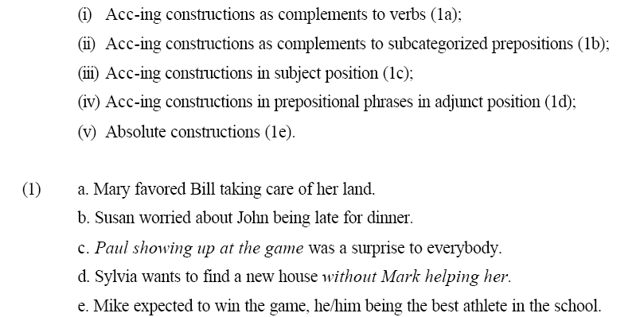
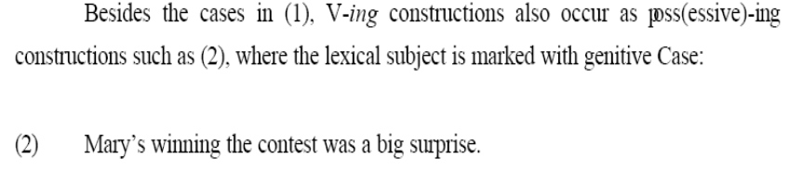
“clausal gerunds - V-ing constructions where the subject is either a PRO or a lexical NP marked with accusative or nominative Case.” (Pires)
-not poss-ing

Slide 4
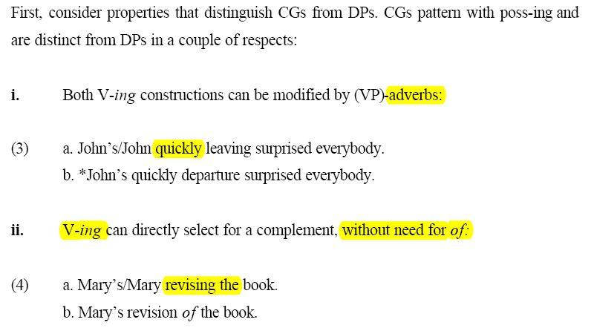
Clausal Gerunds and poss-ing are not just DPs
  Modified by adverbs
  Directly select a complement (no of)

Slide 5
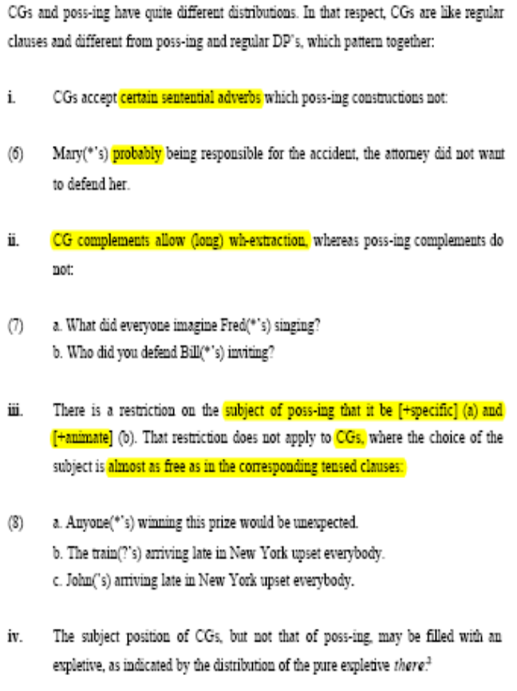

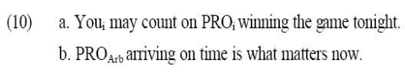
Mary(*’s) probably being responsible for the accident, the attorney did not want to defend her.

Slide 6
Clausal Complements
  Can’t be in a subcategorized PP
    “mary talked about (that) john moved out.”
  Sentential adverbs
  Indirect questions ok
    “Mary talked about why John moved out.”
  Can extrapose
  Cant ccur in the subject position of direct questions with auxiliary inversion
    *Did (that) John kissed Mary bother her parents?
ECM+inf
  Can’t be in a subcategorized PP
Clausal gerunds
  Sentential adverbs
  Long wh-extraction
  +/-specific subject ok
  Expletive subject (there)
  Complex subjects
    “the woman at the door being ...”
  Can be in a subcategorized PP
    “Mary talked about John moving out.”
  Cant extrapose
    “*? It was tragic Paul losing the elections.”
  Can occur in the subject position of direct questions with auxiliary inversion
    Did John kissing Mary bother her parents?
Poss-ing
  No sentential adverbs
  No long wh extraction
  +specific subject
  No expletive subject
  No Complex subjects
    *“the woman at the door’s reading the instructions”
  Can be in a subcategorized PP
    “Mary talked about John’s moving out.”
  Cant extrapose
    * It surprised me Mary’s leaving town. (Williams, 1975 (76)).
DPs
  No sentential adverbs
  long wh extraction?
    “what did you hear john’s rumor about?”
  Can be in a subcategorized PP
  Cant extrapose
    * It surprised me Paul’s loss.
Exposition: require case, no extrapose in English (Reuland 1983)

Slide 7
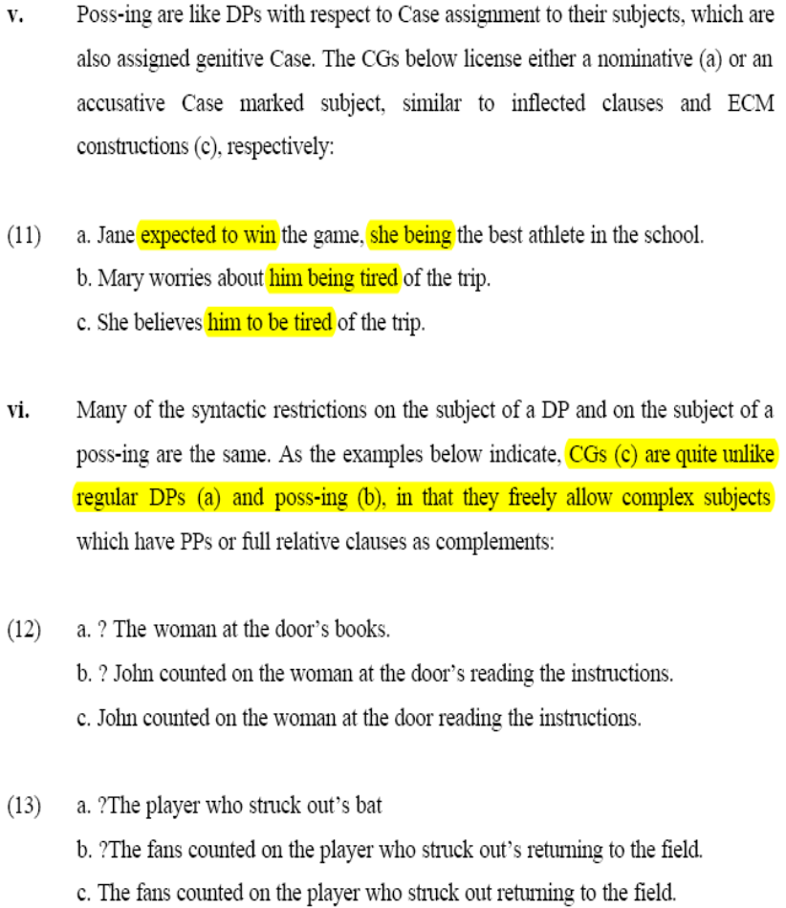
Clausal gerunds are similar to
  Inflected clauses –nom subject
  “she being the best athelete”
  ECM – acc subject
  “She belives him to be tired”

Slide 8
Switched to excel sheet

Slide 9
new slides

Slide 10
noun, to verb
khel, khelnaa, khelaunaa
game, to play, toy
khaanaa, khaanaa
food, to eat
larai, larainaa
fight, to fight
sapnaa
dream
namunaa
example/specimin/type
kaarkaanaa
factory/workshop
gaanaa, gaanaa
song, sing
chik, chikna
sneeze, to sneeze
baajaa, baajaanaa
horn, to make noise
baat, bataanaa
?jhagaRna
?to quarell
chor, chorna
theif, steal
dar, darnaanaa?
fear, scare
talash
search,to search
paRhne paRhna
studies, to study

Slide 11
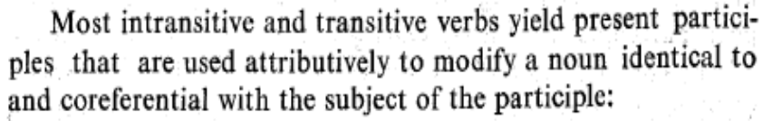
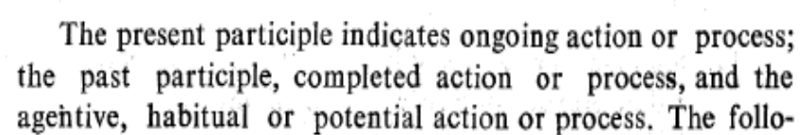
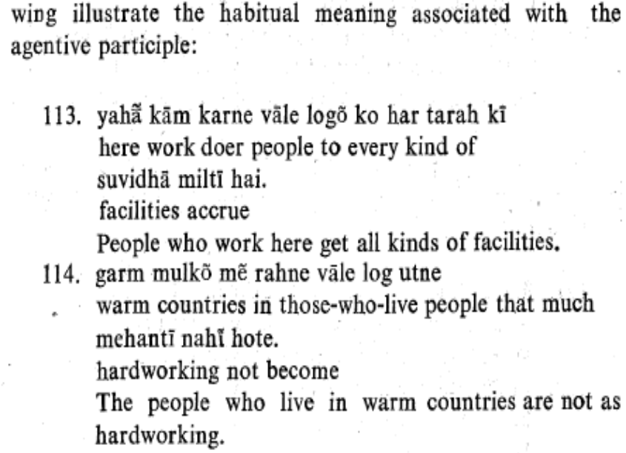
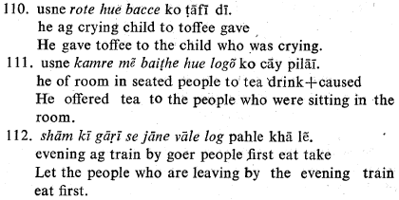
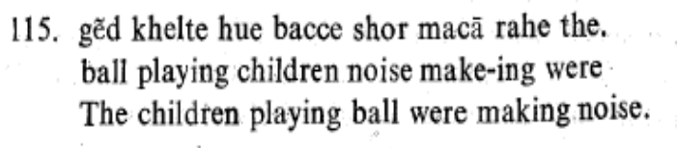
Two sorts of participles/
adj out of verbs
root-Asp-Agr hu-Agr
  ?root-t-Agr present (kelte,jate)
  ?root-y-Agr past
root-N-Agr vaal-Agr
  agentive, has a habitual or future interpretation
s

Slide 12
Summary of NonFinites (Kachru 1980)
Participles
  Inside
  S-ka O root-t-Agr hu-Agr (“Present”)
  S-ka? O root-t-e hi
  S-ka? O root-t-e (“As soon as”
  S-ka O root-y-Agr hu-Agr (“Past”) (120)
  S-ka? O root-n-Agr vaal-Agr (“Agentive”)
  PRO O root kar (“Absolute”)
  locations/adverbials become genitive
  one argument is missing and can be found as the external noun
  apna reflexive can refer to the main clause
  agreement is not obligatory
  default (‘neutral’) forms are –e
  PRO might be replaced by something that is inalienably possessed by the matrix subject (365-368)
  Outside
  modify a head noun (agent of the -t-, theme of the -y-)
  present cant be predicative
  past can be predicative (in the adj of N adj Hai)
  absolutive can be an adverb, all others cannot
Infinitives
  Inside:
  S-ka VP-na
  PRO VP-na
  apna reflexive can refer to the main clause
  Outside
  Subject of adjectives
  Object of prepositions
  Object of verbs
Verbal Nouns
  Inside
  [S-ka O root-n-e] P
  apna reflexive can refer to the main clause
  Outside
  Object of prepositions as an adverb

Slide 13
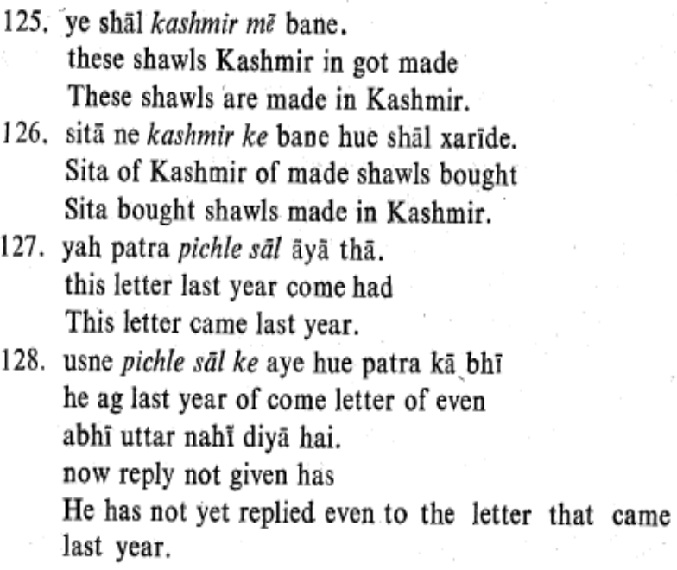

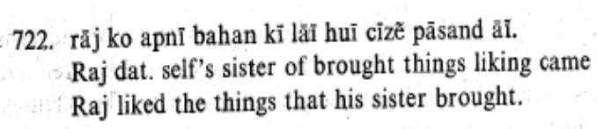
Participles
Three types of Participles
root-t-Agr hu-Agr
root-y-Agr hu-Agr
root-n-Agr vaal-Agr
strangely, locations and adverbs become genitive when they are in participles (126,128)
reflexive pronominal form that refers to the main clause is ok (apna)
“In-case of adjectives as in 386-387, agreement with the object is obligatory. In case of participles, agreement is not obligatory. The neutral forms, e.g., haaste hue, bhaagte hue, leTe hue, baiThe hue, are just as appropriate. In case the adjective or participle refers to the object, and the object is followed by the postposition ko, the adjective or participle must be in the neutral form” (Kachru 1980:87)

Slide 14
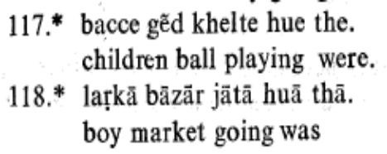
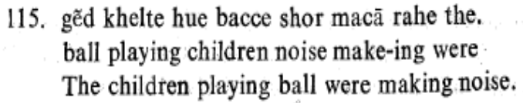
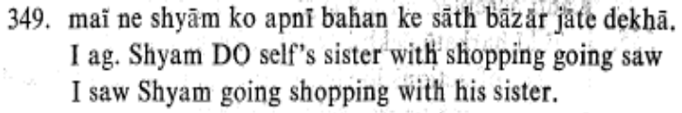
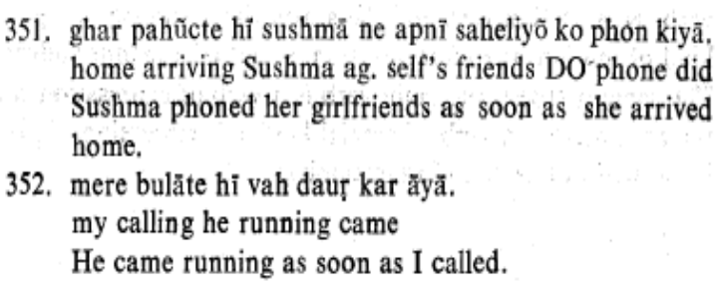
“present” participles root-t-Agr hu-Agr
root-t-Agr hu-Agr
root-t-e hi
root-t-e =as soon as
present participles can be formed from transitive and intransitive verbs.
has a –t- (115)
can’t be used predicatively (117,118)
external noun is subject
the subject of the participle is null
the external noun is the participles Agent
  the external noun is co-reff with the participle’s subject (khelt 115)
i found an example without hue (349)
root-t-e hi
subject conditions are removed

Slide 15
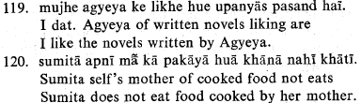
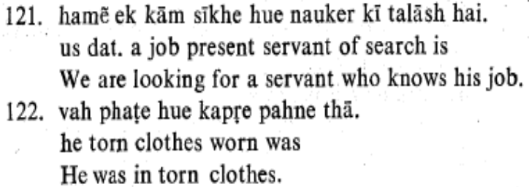
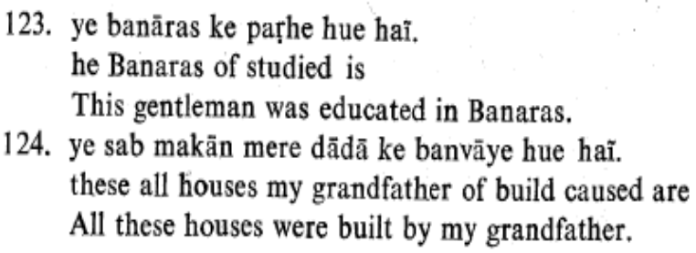
“past” participles root-(y)-Agr hu-Agr
past participles can be formed from transitive verbs.
root-y-Agr hu-Agr
  past (120)
  can be used predicatively (123,124)
  external noun is object
the subject of the participle is genitive
the external noun is co-reff with the object of the participle (likh 119, pakaay 120)
the external noun in some change of state transitives and most intransitives have is co-reff with the subject of the participle (sikh 121, phaT 122) pahan, lagaa
verbs with momentary action cant be past participles (dauRna ‘run’, kudna ‘jump up and down’
I transpose Kachru’s notation to mean that the –y- participle’s Theme is the external noun

Slide 16
NonFinite participles root-n-Agr vaal-Agr
root-n-Agr vaal-Agr
  agentive
  habitual or potential action
  ongoing or completed action

Slide 17
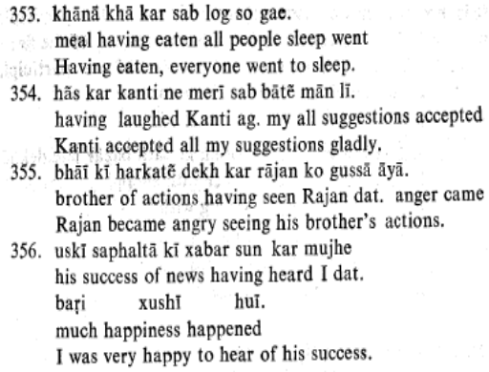
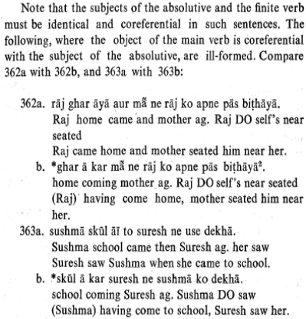
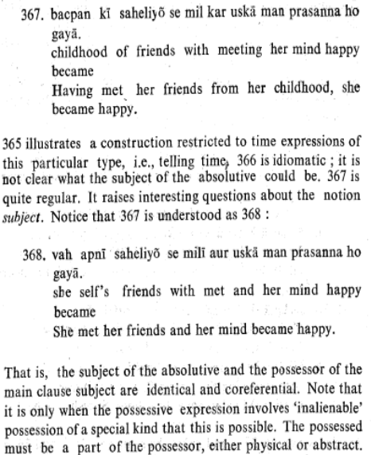
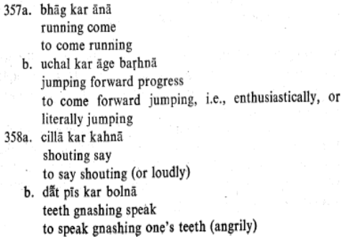
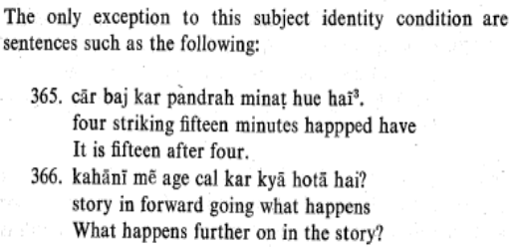
absolute participle
PRO O root kar
PRO O kar ke (instead of kar kar)
time
manner
reason
subjects need to be the same, or the subjects can differ if they are innalenablely possessed

Slide 18
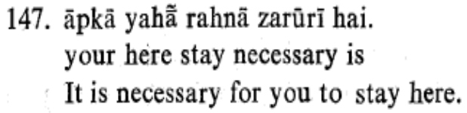
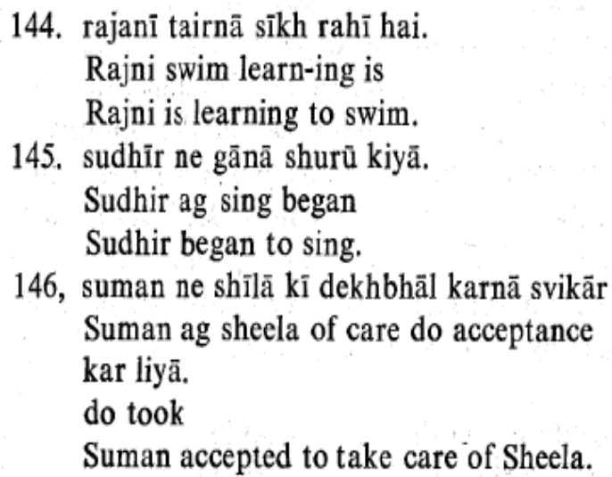

infinitives
(S-ka O V-na) can be subjects (of adjectives zururi, thik, ucit) (147)
(S-ka O V-na) can be object of prepositions
(PRO O V-na) can be an object of sikhnaa, shuru karaa, svikar karaa, xatm karaa, choRnaa, caahnaa, pasand honaa, bhulnaa
(O V-na) can be subject of
S-ko (PRO O V-na) can be the subject of caahiye
reflexive pronominal form that refers to the main clause is ok (apna) (723)

Slide 19
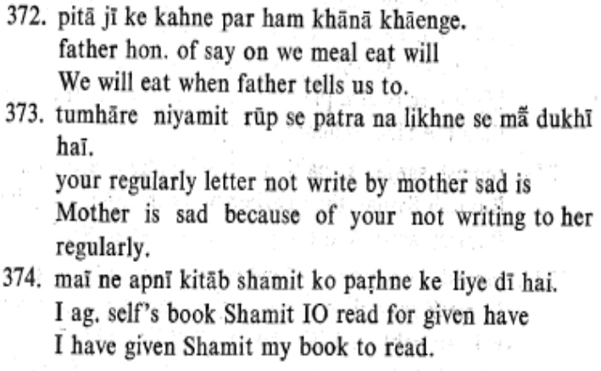
verbal noun
[S-ka O root-n-e] P
as an adverb
time
reason
purpose

